Slide 1
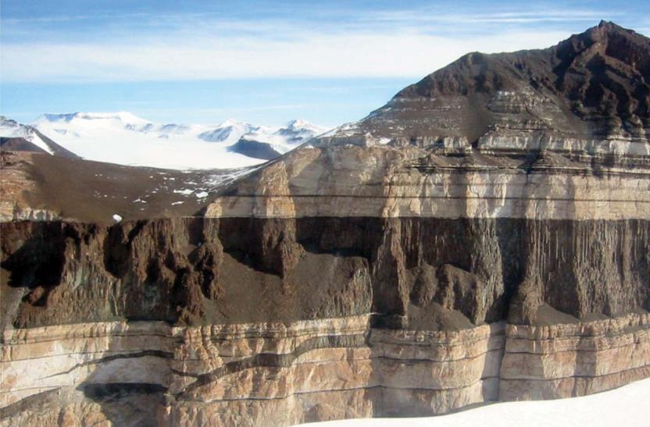
EART11100: Understanding the Earth
A dynamic Planet
How and where do we melt rock?
Jurassic sill, Antarctica

Slide 2
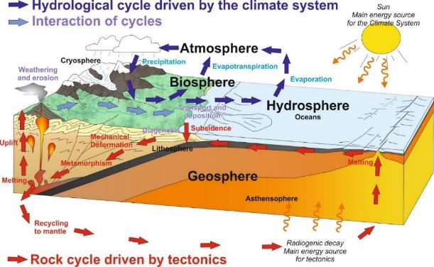
Intended learning outcomes
… you should be able to
explain the main mechanisms for melting in the crust and upper mantle, and
integrate this information into plate tectonics to make predictions about where these different types of melting happen

Slide 3
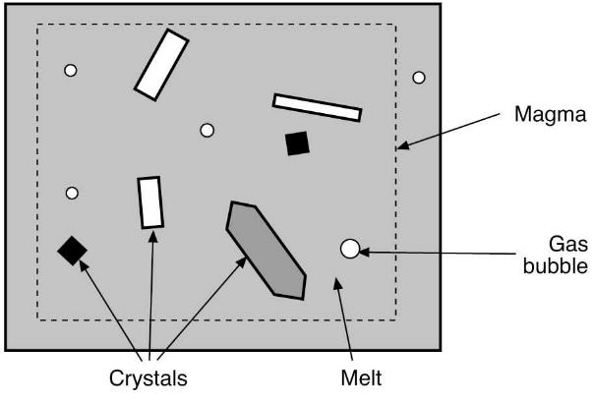
What are igneous rocks?
All igneous rocks crystallise from magma.
Magma is molten rock in the subsurface and usually consists of... liquid (usually silicate liquid)
± crystals
± gas bubbles

Slide 4
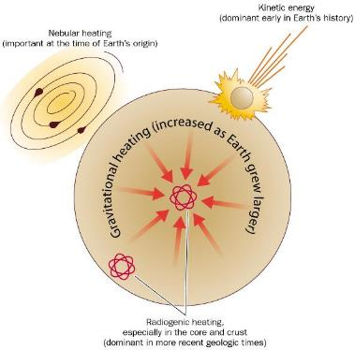
Why do magmas form?
Magmas form because the interior of the Earth is hot:
When the Earth formed from accretion of colliding planetesimals, kinetic energy from the colliding planetesimals → heat energy.
The Earth was so hot that most of it probably melted.
Another early heat source was gravitational energy from iron sinking to form the core.
Throughout Earth’s history, heat is being added from radioactive decay.
The hot Earth loses its heat mostly through magmatism.
(Read more in Marshak Chapter 6)

Slide 5
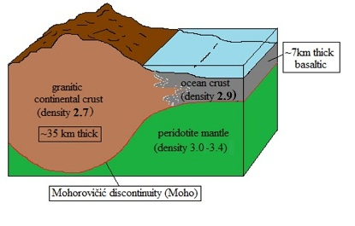
Where do magmas come from?
Recap of the composition of the Earth’s surface
Oceanic crust
Basaltic – “basic”
45-52% SiO₂, high in FeO, MgO, and CaO
Olivine, pyroxenes and plagioclase
Continental Crust
Andesitic – “intermediate”
52-63% SiO₂, high in K₂O and Na₂O
Quartz, Feldspars, Fe and Mg minerals
Upper Mantle
Peridotite – “ultrabasic”
<45% SiO₂, high in FeO and MgO
Olivine and pyroxenes

Slide 6
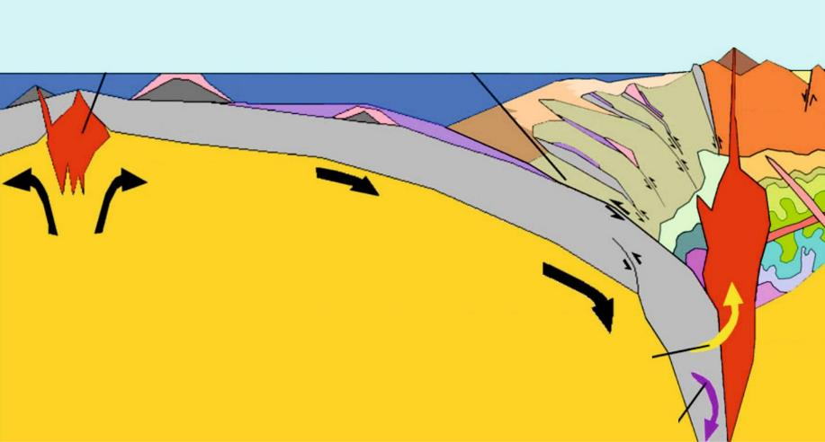
Where do magmas come from?
Upper mantle (ultrabasic), and lower continental crust (intermediate) are the two main location where melting happens
lead two major groups of igneous rocks (give or take)
Why? We will understand by the end of the lecture.
Upper continental crust granite (acidic)
Ocean crust basal (basic)
Melting!
Lower continental crust (intemediate)
Mantle peridotite (ultrabasic)
Melting!

Slide 7
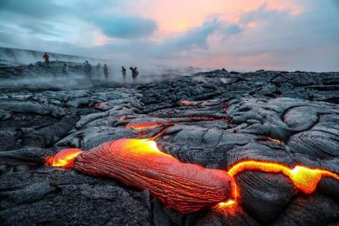
Causes of melting
Volcanoes exist…
… so we know that there must be molten rock – magma – at depth.
But…
…we also know from seismology that the Earth’s interior is mostly solid to base of mantle
Production of magma must be:
(1) localised
(2) require special conditions.

Slide 8
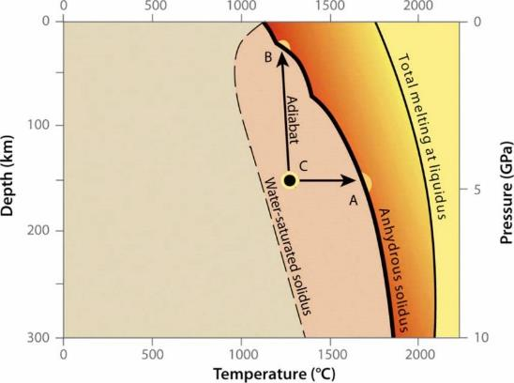
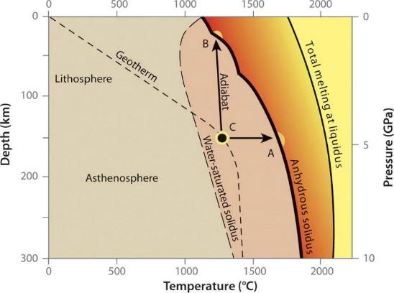
Melting temperatures of mantle peridotite as a function of pressure (depth)
Causes of melting
Melting will be caused by increasing the temperature of the rock to above its melting point.
The melting point of rock increases with pressure (and depth)
  this profile is called the solidus.
Melting can only occur if the geotherm (T vs. depth curve) intersects the solidus.
Which it normally does not!

Slide 9
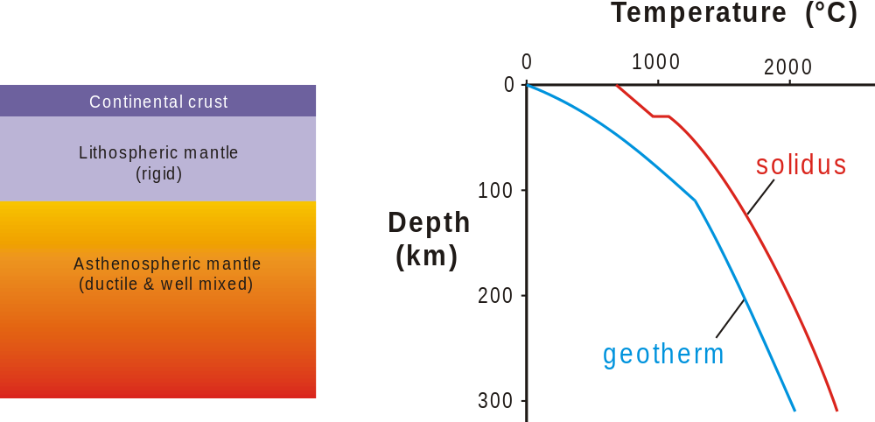
Causes of melting
= temperature at which rocks start to melt
but solid
= relationship of temperature to depth in the Earth

Slide 10
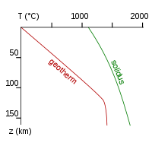
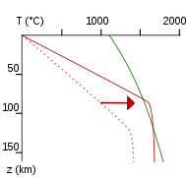
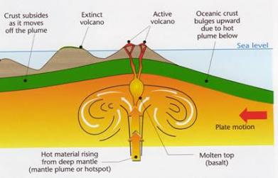
Causes of melting – heating
So what can we do to melt?
Basic case - we can introduce heat.
Upwelling of warm mantle plume.
Melting occurs relatively deeply (~100 km) through partial melting of mantle peridotite
Ambient mantle geotherm
Mantle plume geotherm
melting
Basaltic melt rises due to its lesser density of the new phase
This is how Ocean Islands (“Seamounts) are produced.

Slide 11
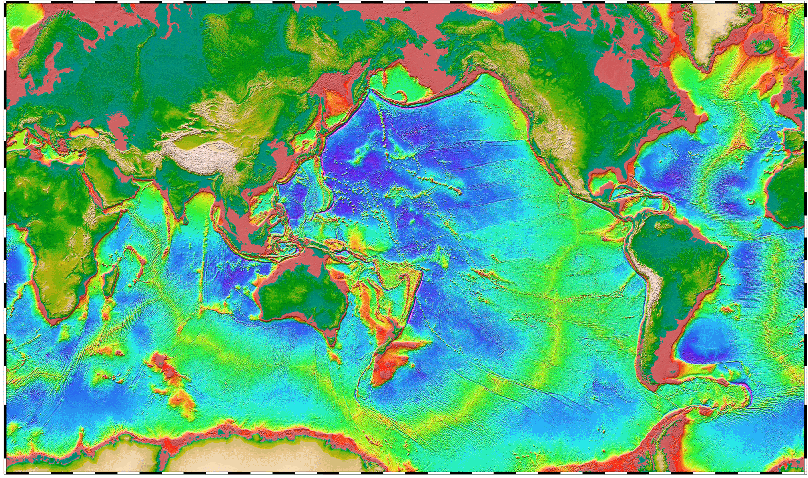
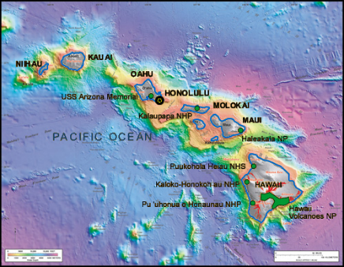
Causes of melting – heating
E.g. Hawaiian Chain

Slide 12
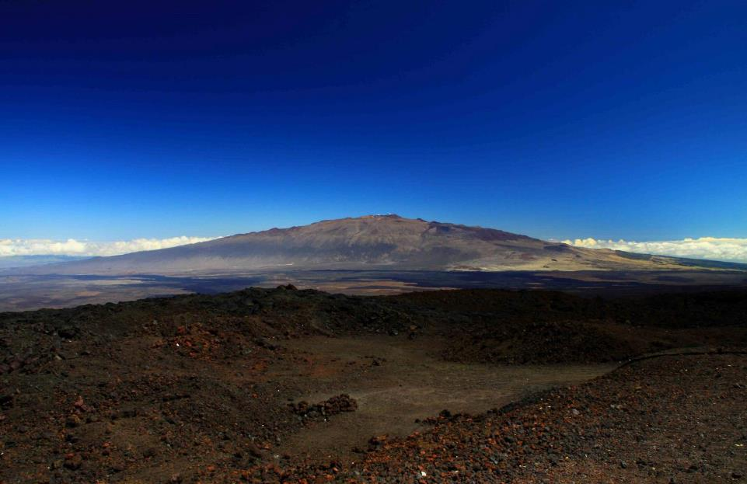
Mauna Kea – an Ocean Island Volcano
Causes of melting – heating

Slide 13
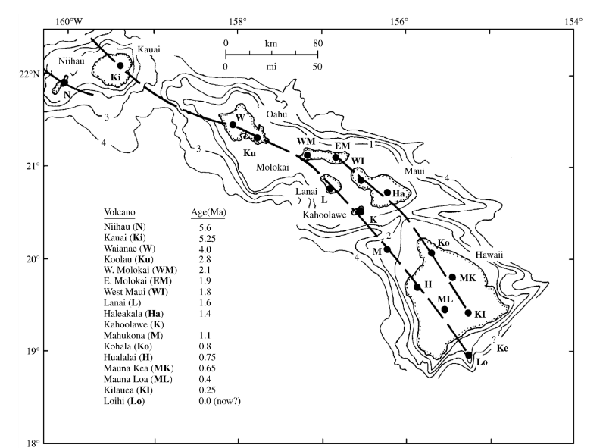
Causes of melting – heating
plate
motion

Slide 14
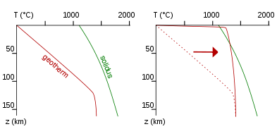
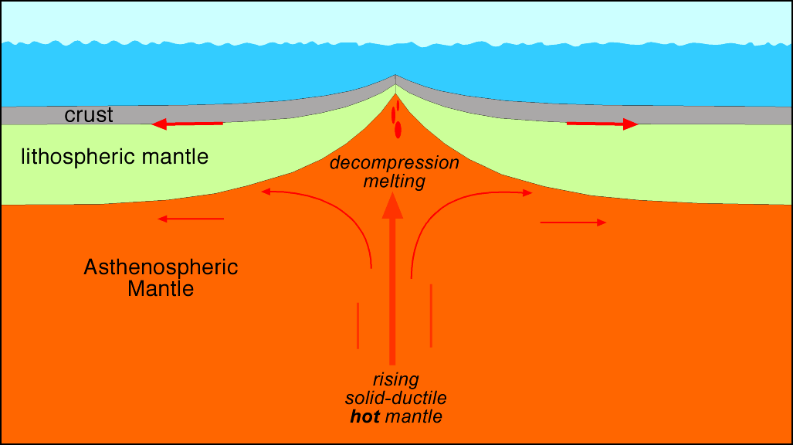
Causes of melting – decompression
In practice, most common cause is “decompression melting”.
Ambient mantle geotherm
Mid-ocean ridge geotherm
Oceanic crust extended and thinned.
This removes the “lid” over the mantle, and the shallow geothermal gradient is steepened
melting
NO HEAT INTRODUCED!
Basaltic melt is produced through partial melting of the peridotite mantle.
This is how Oceanic Crust is produced at Mid Ocean Ridges.

Slide 15
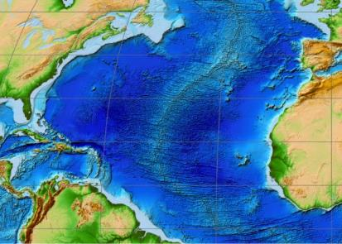
Causes of melting – decompression
E.g. Central Atlantic (amongst many)

Slide 16
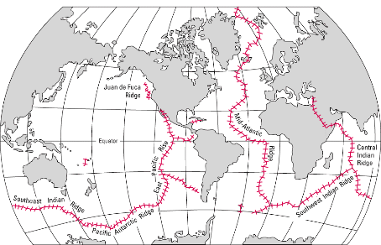
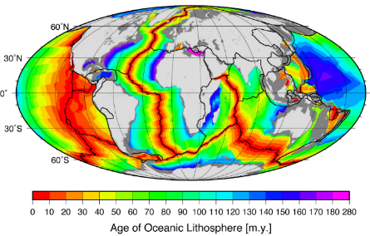
Causes of melting – decompression
Oceanic crust covers ~70% of the Earth’s surface
18 km³/yr erupted compared to 4 km³/yr at Ocean Islands
ridges
65,000 km of mid-ocean
Oldest oceanic lithosphere is ~200 Ma

Slide 17
Causes of melting – addition of water
Addition of water to crystal structure of a mineral – usually creating a new mineral.
  Effectively the opposite of weathering reactions.
  changes fundamental properties of rocks, incl. melting temperature
How can we add water?
Via subduction (occurs to a lesser degree in other settings)

Slide 18
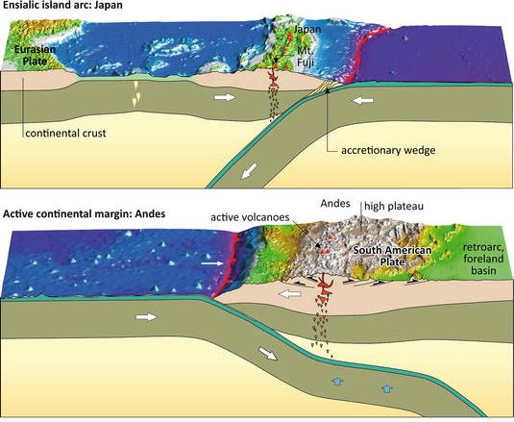
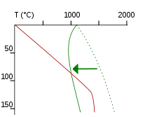
Causes of melting – addition of water
Ocean-ocean subduction and ocean-continent subduction
Position of solidus shifted to intersect the natural geothermal gradient – melting.
Basalts, Andesties and Granites produced (more complex)
melting

Slide 19
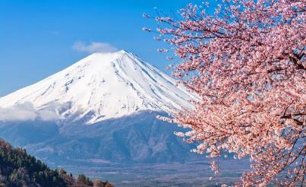
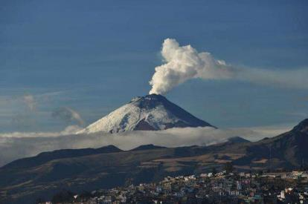
Causes of melting – addition of water
E.g. Japanese Arc
E.g. Andes

Slide 20
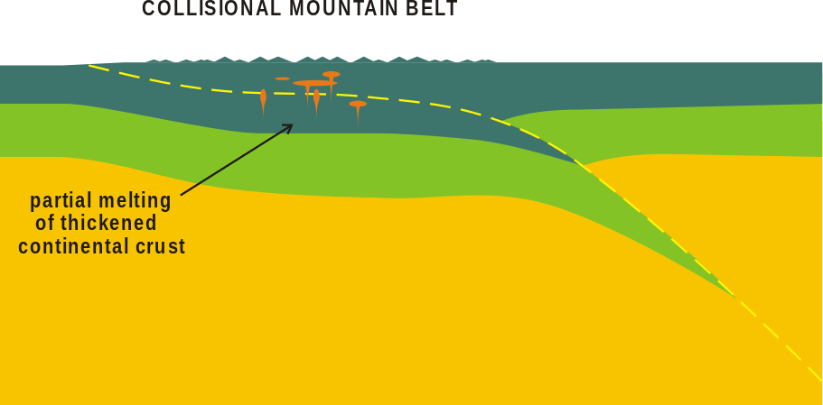
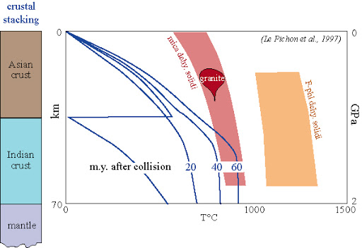
Melting in orogenic belts (heating)
Rather more complex, but is fundamentally by heating.
Continental-continental collision effectively results in doubling of crustal thickness
The cold underriding slab is warmed
Rock is a terrible conductor of heat
So the thick continental crust cannot lose radiogenic heat fast enough
Resulting in heating of the crust above the granite solidus.
E.g. Himalayas

Slide 21
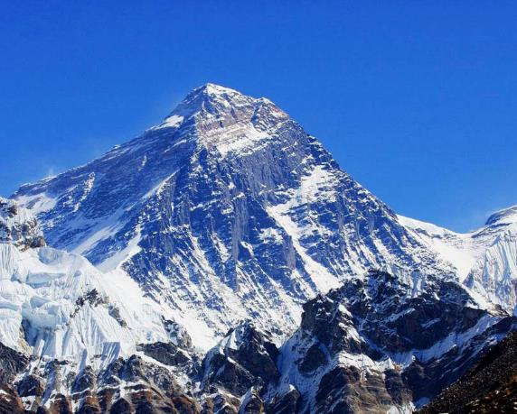
Melting in orogenic belts (heating)
Everest (8848 m)
Qomolangma detachment
E.g. Himalaya
Limestones
Pelites
Lhotse detachment
Granites and gneisses: Nuptse leucogranite

Slide 22
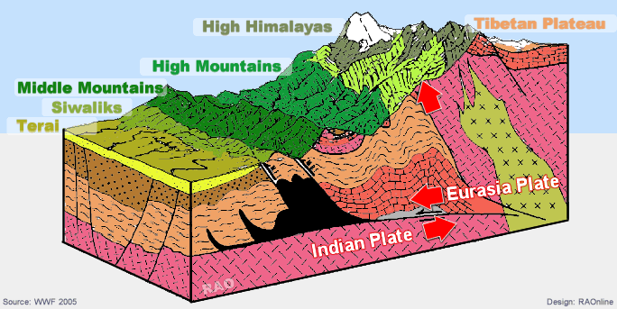
Melting in orogenic belts (heating)

Slide 23
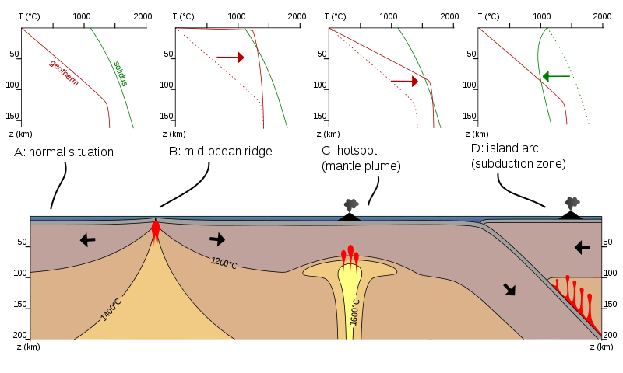
Causes of melting - summary
Change temperature
Mantle plumes
Orogenic lithospheric thickening
Change pressure
Lithospheric thinning
Change H₂O

Slide 24
EART11100: Understanding the Earth
A dynamic Planet
What’s the composition of molten rock?
Jurassic sill, Antarctica

Slide 25
Intended learning outcomes
… you should be able to
explain why molten rock is typically either felsic (acidic) and mafic (basic) in composition.

Slide 26
Where does melting happen?
Change temperature
Mantle plumes
Orogenic lithospheric thickening
Change pressure
Lithospheric thinning
Change H₂O

Slide 27
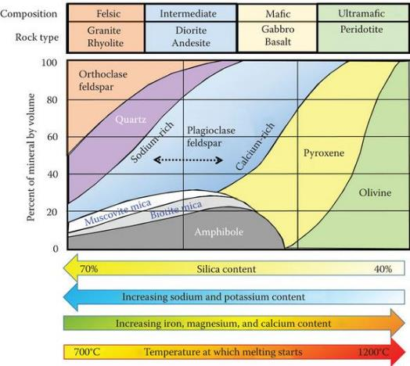
What determines magma composition?
Magmas can be derived from mantle or crust. Composition of the magma initially formed depends on …
(1) Composition of the source rocks:
Mantle peridotite = ultrabasic
Olivine, Pyroxene and Garnet
‘Average’ continental crust = intermediate
Feldspar, pyroxenes or micas, lesser Quartz and amphiboles

Slide 28
What determines magma composition?
(2) Degree of partial melting
Total melting of mantle peridotite (ultrabasic)→ ultrabasic magma
Total melting of ‘average’ crustal rock (intermediate) → intermediate magma
In reality, total melting rarely happens
The parent rock is made up of a variety of minerals with different melting points, and…
Temperatures aren’t high enough.

Slide 29
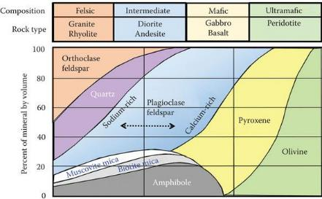
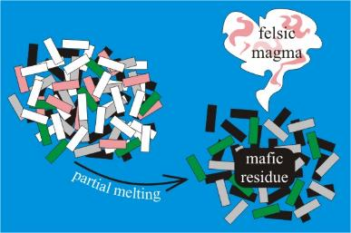
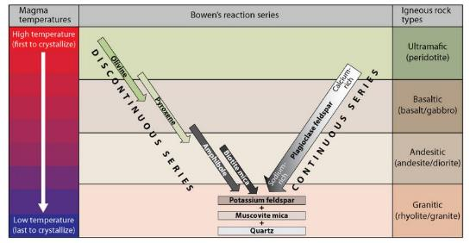
What determines magma composition?
Lower temperature minerals will melt, leaving behind a residue of higher temperature minerals
→ Magmatic differentiation during partial melting.
~1300ºC
~750ºC

Slide 30

What determines magma composition?
This results in a melt that is usually more acidic (“felsic”) than the parent material
Partial melting of our two main melt sources
Mantle peridotite→ basaltic melt (Pg Feldspars and pyroxenes)
Intermediate lower continental crust→ felsic melt (K and Pg Feldspars, Quartz, micas)

Slide 31
Summary
Melting usually happens in the asthenosphere (hot-spots, decompression), or in the lower continental crust (subduction zones and orogenic belts).
The asthenosphere is ultrabasic in composition and the continental crust is intermediate in composition
But neither of the fully melt (partial melting), so a residue of high temperature minerals is left behind, and low temperature minerals melt and rise to form a melt.
These melts are basic, and felsic, respectively.

Slide 32
EART11100: Understanding the Earth
A dynamic Planet
Intrusive igneous rocks
Jurassic sill, Antarctica

Slide 33
Intended learning outcomes
… you should be able to explain why
magma rises, and intrusive igneous rocks cool slowly
slow, fractional crystalisation results in phaneritic, cumulate, and porphorytic textures, that are characteristic of intrusive igneous rocks

Slide 34
Why do magmas rise?
Magmas rise primarily because of two main physical properties:
They are less dense
Melting causes the break-up of the organised mineral crystal structure,
Atoms are more randomly and less efficiently organised – a more open and less tightly (densely) packed structure.
 | Density (g/cm³) as liquid (1250 ºC) | Density (g/cm³) as solid
Acid | 2.2 | 2.7
Intermediate | 2.4 | 2.85
Basic | 2.6 | 3.0

Slide 35

Why do magmas rise?
2) They can flow (are viscous)
Varies with composition:
Viscosity in Pa s at 1200 ºC
Basic Magma 10-100
Intermediate Magma 1,000-10,000
Acid Magma 100,000-1,000,000
H₂O at 20 ºC 0.001
Honey at 20 ºC ~10
This has implications for ....
.... style of eruption (explosive vs. non-explosive)
.... architecture of volcanoes
See later!

Slide 36
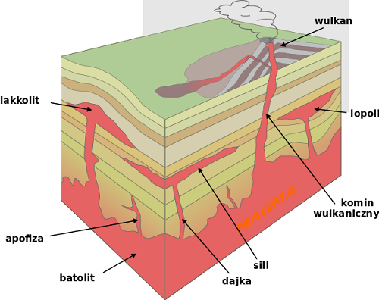
Where do the magmas go?
Magmas rise and can…
crystallise beneath the Earth’s surface
  Deep (>2 km) – “plutonic” – tend to be coare grained
  Shallow (<2 km) – “hypabyssal” – between plutonic and volcanic
erupt on the Earth’s surface – “volcanic” – tend to be fine grained
These are
“intrusive”
Later in the lecture
Volcano
Fundamentally controlled by
Rate of magma production
Temperature of the host “country” rock
Size and shape of the conduits (surface area: volume ratio)
Laccolith
Lopolith
Dyke
Dyke
Sill
Batholith
Dyke

Slide 37





Cooling and crystalisation of magmas
Volcano
A
Laccolith
Lopolith
B
Dyke
Dyke
C
Sill
Batholith
Dyke
E
D
Organise A-E according to the rate at which they cool (slowest to fastest).

Slide 38
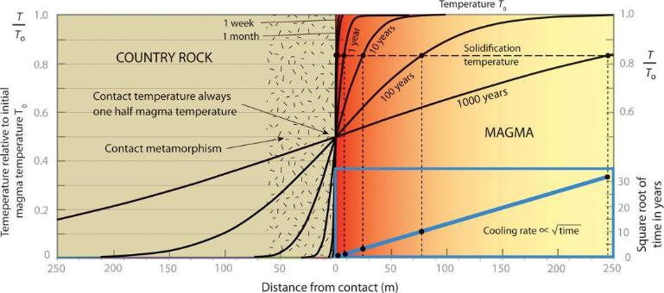
Cooling and crystalisation of magmas
Intrusive melts cool slowly
This is not the case for extrusive (volcanic) rocks.
This is because rock is a very poor conductor – the magma loses its heat to the country rock slowly.
Latent heat of crystallisation slows down the cooling rate (second derivative).

Slide 39
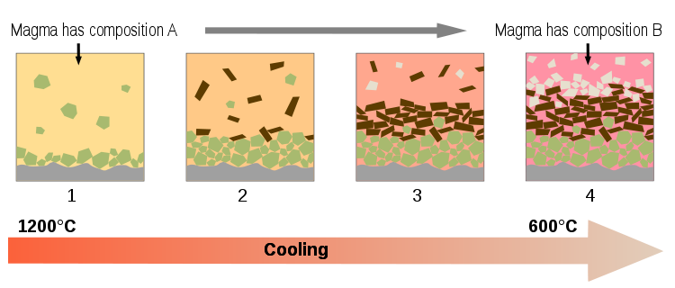
Cooling and crystalisation of magmas
Because magmas are complex mixtures (that have already undergone differentiation from their parent material during partial melting), slow cooling rates result in “Fractional Crystallisation”.
As the temperature descends, high temperature minerals form at their melting T, leaving behind a melt that is enriched in the components of lower T minerals.

Slide 40
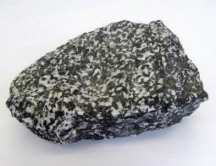
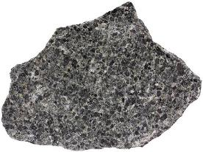
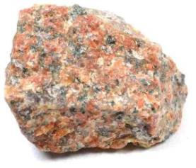
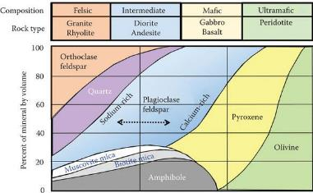
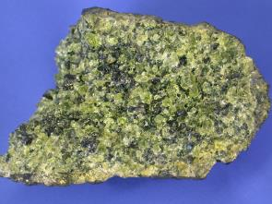
Intrusive igneous rock textures
Slow cooling of intrusive igneous rocks results in the ready formation of crystals out of the melt – visible to the naked eye.
“Phaneritic” texture – useful word with hand specimens/in the field.

Slide 41
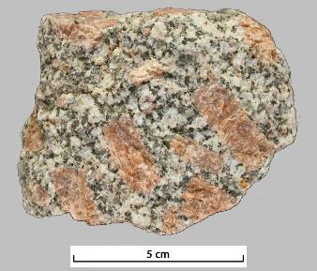
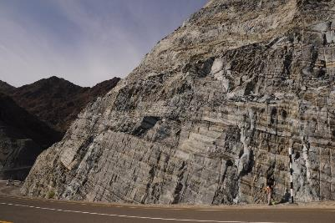
Intrusive igneous rock textures
Porphorytic granite
Cumulate textures, Oman
Fractional crystalisation and multi-stage cooling result in the formation of cumulate and porphorytic textures.

Slide 42
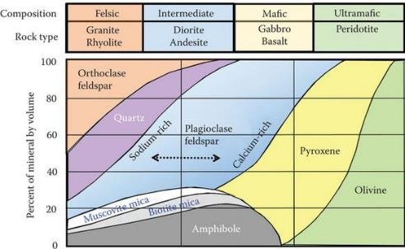
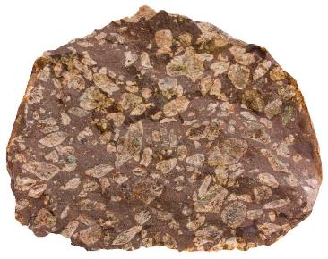
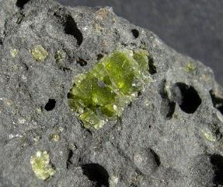
Intrusive igneous rock textures
~1300ºC
~750ºC

Slide 43
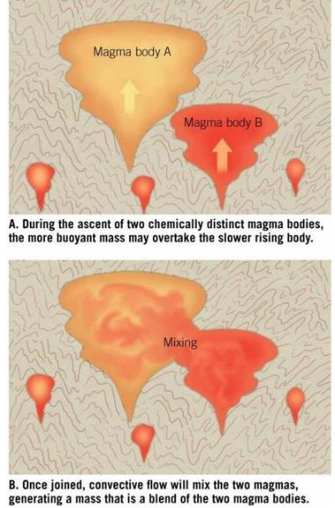
Other differentiation processes
Magma mixing is another example of magmatic differentiation.
It is the physical mixing of two magma types to give a new homogeneous one.
e.g. acidic (rhyolitic) magma formed by partial melting continental crust…
… mixes with basic (basaltic) magma formed by partial melting in the mantle
…to form a melt with intermediate (andesitic) composition.

Slide 44
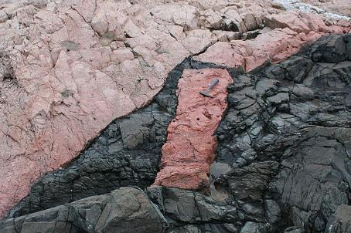

Other differentiation processes
Xenolith of rhyolite in a basaltic matrix
Partial melting of wall rock and “stoping”.
Heat provided by the magma can melt the wall rock
blocks of wall rock can be incorporated into the melt (stoping)
The material dissolves and mixes into the melt to form a new composition.
More common in basic intrusives.

Slide 45

EART11100: Understanding the Earth
A dynamic Planet
Where do volcanoes form?
The Eruption of the Soufrière Mountains in the Island of St Vincent, 30 April 1812, JMW Turner

Slide 46
Intended learning outcomes
You should be able to
define a volcano
explain where volcanoes form

Slide 47



What is a volcano?
A volcano is a rupture in a planet’s surface, through which molten rock, and/or ash and gasses escape from an underlying magma chamber.
Is a volcano a mountain?
Submarine eruption, Iceland.
Olympus Mons, Mars.
Vesuvius, Italy.

Slide 48

What is a volcano?
They have a variety of shapes and sizes depending on key geological controls, which we will discuss in this lecture.
They lead to deposits on the Earth’s surface, so they represent
→ an interface between internal and Earth surface processes.
→ a major hazard to the environment, infrastructure and civilisation
White Island, New Zealand
They bring minerals to the surface which fertilises land and aids agriculture.
They release gasses and dust which can have major impacts on the Earth’s climate system.

Slide 49







Tectonic setting of volcanoes
Where melting happens (first video)
Doesn’t usually lead to volcanism
Change temperature
Mantle plumes
Orogenic lithospheric thickening
Change pressure
Lithospheric thinning
Change H₂O
Ocean spreading
Continental rifting
Continental and ocean hot-spots
Ocean-ocean and Ocean-continent subduction
EXTENSIONAL
CONTRACTIONAL

Slide 50
On your computer’s or phone’s web browser, go to
kahoot.it
You can download the kahoot app or bookmark the website for future lectures.
Notes:
A negative feedback stabilizes the climate system, counteracting the original action.

Slide 51
EART11100: Understanding the Earth
A dynamic Planet
Eruption products
The Eruption of the Soufrière Mountains in the Island of St Vincent, 30 April 1812, JMW Turner

Slide 52
Intended learning outcomes
You should be able to
describe the main controls on eruption style
describe the main eruptive products of submarine and subaerial volcanoes.

Slide 53
Eruption style: controls
Eruptive style is controlled by
  1. Viscosity of magma and lava
  →Which also controls gas pressure
  2. Environment of emplacement (submarine versus subaerial)

Slide 54



Eruption style: controls
1. Viscosity of magma and lava
Viscosity is the measure of the capability of a magma (or any material) to flow. It is controlled by:
Temperature – viscosity decreases with temperature.
Composition
→ (SiO₂ content) – acidic (felsic) melts are always more viscous than basic (mafic) melts.
→Water content – melts with high dissolved water content are always less viscous.
The two major types of melt formed

Slide 55

Eruption style: controls
As magma ascends (decreasing pressure):
Temperature decreases
H₂O solubility decreases
Crystal content increases
⇒ viscosity increases
At depth (high pressure):
Temperature is high
H₂O solubility is high
Crystal content is low
⇒ viscosity is low
Explosive eruptions are more likely when the magma is:
SiO₂-rich: highly polymerised melts have higher viscosity
H₂O-rich: the more exsolved gas trying to escape, the more pressure builds up in bubbles
High eruption rate: less time for exsolved gas to escape

Slide 56

Eruption style: controls
Fragmentation: if viscosity and bubble pressure are high enough, an explosive eruption will occur.
Vesiculation horizon: H₂O exsolves and gas bubbles form. At the same time, T is decreasing and the crystal content increasing. Viscosity increases.
High pressure: all H₂O is dissolved in the melt.

Slide 57
Eruption style in submarine settings
2. Environment of emplacement (submarine/aqueous)
Common at
→mid ocean spreading centres
→mantle hot spots beneath oceanic crust
→early stages of Oceanic Arc formation (Ocean-Ocean subduction).
Ocean spreading
Continental rifting
Continental and ocean hot-spots
Ocean-ocean and Ocean-continent subduction
EXTENSIONAL
CONTRACTIONAL

Slide 58
Eruption style in submarine settings
Ocean spreading centres and mantle hot spots beneath oceanic crust are dominated by partial melting of ultrabasic mantle peridotite
→ Melts are basic (mafic)
Subducting ocean plates are dominated by partial melting of basic ocean crust and intermediate lower continental crust
  → Melts often variable
Submarine setting means the melts often become saturated in H₂O.
  → Overall, melts in these settings are often have low viscosity.
Ocean spreading
Continental rifting
Continental and ocean hot-spots
Ocean-ocean and Ocean-continent subduction
EXTENSIONAL
CONTRACTIONAL

Slide 59


Eruption style in submarine settings
Because eruptions are often deep underwater, much of what we understand about submarine volcanism is derived from looking at rocks that have been later uplifted and exposed on land.
→More recently, we have been able to make direct observations.
Exposed slither of mantle-ocean crust in the Swiss Alps.

Slide 60


Eruption style in submarine settings
At sufficient water depths, high water pressure keeps gasses dissolved in the melt
The low viscosity lava erupts as pillow lavas.
Glassy rind forms by rapid quenching when lava comes into contact with cold water
Pillow basalts, Llanddwyn Island, Anglesey
http://www.youtube.com/watch?v=DdIUuUY0L9c
The rind is initially warm and ductile, so it inflates as more magma is injected into it. Eventually it cracks and a new pillow breaks through
Pillow interiors have radial cooling joints perpendicular to the cooling surface

Slide 61

Eruption style in submarine settings
As the volcano grows upwards
→The pillow lavas reach angle-of-repose, and may begin to break and tumble down, forming aprons of pillow lava debris: stratification
→Feeding dykes and tubes intrude the older pillow lavas.
→It extends to lower water pressures, where water and other gasses exsolve, increasing bubble pressure
→Eruption style become explosive, pillows cease forming, replaced with hyaloclastites – glassy chaotic basaltic fragments.

Slide 62

Eruption style in submarine settings

Slide 63

Eruption style in submarine settings
https://www.youtube.com/watch?v=CsKTzBZNjtE
→Rapid cooling of the lava in contact with sea water leads to rapid exsolution and rapid increase in pressure.
→Eruptions with magma-water interactions are called phreatomagmatic.
→This style is called “Surtseyan” after the island of Surstey, Iceland which formed this way.

Slide 64
Eruption style in subaerial settings
2. Environment of emplacement (subaerial = on land)
Common
→where volcanoes at mantle hot beneath ocean crust have grown above sea level, and at mantle hot spots below continental crust.
→in the latter stages of Oceanic Arc formation (Ocean-Ocean subduction).
→in Continental Arc settings (Ocean-Continent subduction)
→on continental rifts
Does not happen at mid ocean spreading centres (Iceland is an exception and coincides with a mantle hot spot).
Ocean spreading
Continental rifting
Continental and ocean hot-spots
Ocean-ocean and Ocean-continent subduction
EXTENSIONAL
CONTRACTIONAL

Slide 65
Eruption style in subaerial settings
Mantle hot spots beneath oceanic crust are dominated by partial melting of ultrabasic mantle peridotite
→ Melts are basic (mafic)
Subducting ocean plates are dominated by partial melting of basic ocean crust and intermediate lower continental crust
  → Melts often variable
Mantle hot spots beneath continental crust and continental rifting dominated by partial melting of the lower continental crust
    → Melts are acidic (felsic)
Subaerial settings show high variability
Ocean spreading
Continental rifting
Continental and ocean hot-spots
Ocean-ocean and Ocean-continent subduction
EXTENSIONAL
CONTRACTIONAL

Slide 66


Eruption style in subaerial settings
On land, erupted material is either as
  Lava flows, or
  Pyroclastics (“fire pieces”) = rock fragments
Holuhraun, Iceland, August 2014
Sinabung, Indonesia, July 2015

Slide 67


Eruption style in subaerial settings
Lava flows
Molten rock flowing on the land surface.
These are more common when basic or intermediate lava is erupted.
Pahoehoe: hot, low-viscosity lava
`A`a: cooler, higher viscosity lava
Smooth, billowy, ropy surface
Vesicular interior
Fast flow rates
Individual flows may be thin (1-3 m) and long (>50 km)
Rough, rubbly and fragmented surface
Vesicular interior
Slower flow rates
Individual flows are thicker (5-20+ m) and shorter than pahoehoe

Slide 68

Leilani Estates eruption, Kilauea East Rift Zone, 3rd May to 15th August 2018
Eruption style in subaerial settings
Lava flows are disruptive because they can destroy infrastructure and crops….
… but are rarely dangerous to life because they do not usually flow fast enough.

Slide 69


Eruption style in subaerial settings
Thick, slowly cooling lava flows develop a characteristic “columnar” jointing style
Columns develop perpendicular to cooling isotherms due to contraction.
Colonnade: regular columns with 3 to 8 near-planar sides
Entablature: thinner, less regular columns with curving sides. Forms when two opposing joint sets meet, or when water penetrates the flow.

Slide 70


Eruption style in subaerial settings
Above: Staffa, NW Scotland (61 Ma old)
Left: Giant’s Causeway, Northern Ireland (50-60 Ma old).

Slide 71




Eruption style in subaerial settings
2. Pyroclastics
Fragments of rock erupted solid from the volcanic vent.
These are more common in intermediate to acidic settings.
Occur in two basic forms:
Pyroclastic flow and surge deposits:
Deposited by gravity flows of mixtures of rock fragments and hot air, which are denser than the ambient air.
Pyroclastic fall deposits:
Formed by fallout from eruption column

Slide 72

Eruption style in subaerial settings
Pyroclastic fall deposits are the most basic type.
Material of different grain sizes is ejected into the air, and fall out via suspension settling.
→ Ash particles are <2 mm in diameter. Consolidated deposit (i.e. rock) is called a tuff.
→ Lapilli are fragments 2 mm to 64 mm in diameter. Rock is called a lapilli-tuff.
→ Bombs or blocks are >64 mm. Rock is called a volcanic bomb or block breccia.
Ash fall deposits form layers which blanket topography. From the eruption of Chimborazo, Ecuador.

Slide 73

Eruption style in subaerial settings
Pyroclastic flow and surge deposits are more complex.
Eruption material and gas form a mixture. This mixture is denser than the ambient air, and so collapses under its own gravity.
→Hugs the floor as it does so.
We will revisit gravity deposits later in the course.
The flow wanes as turbulent mixing decreases the density contrast between the flow and the air.
As the flow wanes, it begins to deposit its coarsest load
→Leads to “normally” graded deposits.

Slide 74


Eruption style in subaerial settings
Pompeii
Pyroclastic gravity flows are extremely dangerous to human civilisation.
Pompeii and Herculaneum were destroyed by these when Vesuvius eruputed in AD 79
At least 13,000 people were killed.
Herculaneum
You can read more in this recent scientific study
https://doi.org/10.1371/journal.pone.0203210

Slide 75

Eruption style in subaerial settings
https://www.youtube.com/watch?v=u76clm5_Qpw
Examples of pyroclastic fall-out, and flows, Mount Etna, January 2015.

Slide 76
EART11100: Understanding the Earth
A dynamic Planet
The four main types of volcano
The Eruption of the Soufrière Mountains in the Island of St Vincent, 30 April 1812, JMW Turner

Slide 77
Intended learning outcomes
You should be able to
describe the four main types of volcano, and
explain the processes that form them, and
Where they are most likely to form.

Slide 78

The four main types of volcano
Variability in composition (viscosity), eruption speed of the lava, and environmental setting of the volcano results in different eruption styles.
Basic to intermediate composition tend:
→ low explosivity
→dominated by lava flows
→low volumes of pyroclcastics
→regular/continuous eruptions
Intermediate to acidic composition tend:
→ high explosivity
→dominated by pyrolastics
→low volumes of lava flows
→Irregular eruptions interspaced by quiescence.

Slide 79
The four main types of volcano
VEI Description Plume height Volume Classification How often Example
0 non-explosive <100 m <10,000 m³ hawaiian constant/daily Kilauea
1 gentle 100-1000 m >10,000 m³ haw/strombolian daily Stromboli
2 explosive 1-5 km >1,000,000 m³ strom/vulcanian weekly Sinabung 2010
3 severe 3-15 km >10,000,000 m³ vulcanian few months Nevado del Ruiz 1985
4 cataclysmic 10-25 km >0.1 km³ vulc/Plinian ≥1 yr Galunggung 1982
5 paroxysmal >25 km >1 km³ Plinian ≥10 yrs Mount St Helens 1980
6 colossal >25 km >10 km³ Plin/ultra-Plinian ≥100 yrs Krakatau 1883
7 super-colossal >25 km >100 km³ ultra-Plinian ≥1000 yrs Tambora 1815
8 mega-colossal >25 km >1000 km³ ultra-Plinian ≥10,000 yrs Yellowstone 2 Ma
Pyle DM (2000) Sizes of volcanic eruptions. Encyclopedia of Volcanoes, pp 263-269.
VEI 0-1 Always basaltic
VEI 2 Basalt or basaltic andesite
VEI 3-4 Usually basaltic andesite to dacite
VEI 5-8 Usually dacitic or rhyolitic, although there are rare examples of basaltic Plinian eruptions in the geological record

Slide 80


The four main types of volcano
This leads to the formation of four basic volcano types (not an all-encompassing classification):
1) Shield volcanoes
2) Lava domes
3) Composite cones/
stratovolcanoes
4) Cinder cones

Slide 81
The four main types of volcano
Shield volcanoes (e.g. Hawaii)
Basic composition
Low explosivity (Hawaiian)
Low viscosity lavas which flow long distances before solidifying.
Little or no pyroclastics.
Made up virtually exclusively of lava flows.
Largest volcanoes on Earth (and the Solar System): broad and gently sloping.

Slide 82

The four main types of volcano
Stratovolcanoes (e.g. Fiji, Vesuvius)
Intermediate to acidic composition
Moderate to high explosivity (Strombolian to Plinian)
Moderate to high viscosity lavas and pyroclastics.
Made up interstratified pyroclastics and lavas.
Archetypal volcano. Large, with concave-up, steep profile.

Slide 83

The four main types of volcano
Lava Domes (e.g. Paluweh, Indonesia)
Basic to intermediate composition
Low explosivity (Hawaiian)
Moderate to high viscosity lavas.
Little or no pyroclastics
Made up interstratified lavas, and lava blocks.
Small, often subsidiary (flank or caldera eruption) to larger stratovolcanoes.

Slide 84

The four main types of volcano
Cinder Cones (e.g. Etna, Italy)
Basic to acidic composition
Low to moderate viscosity lavas, which fountain, solidify in the air, forming lapilli-sized fragments which fall more-or less in place.
Made up almost exclusively of these pyroclasts.
Small, often subsidiary (flank or caldera eruption) to larger shield of stratovolcanoes. Often the product of a single eruption.

Slide 85
Summary
There are four basic volcano types (not an all-encompassing classification):
1) Shield volcanoes
2) Lava domes
3) Composite cones/
stratovolcanoes
4) Cinder cones

Slide 86



Further reading
Marshak, Earth: Portrait of a Planet, Ch. 6, Ch. 9.
Klein and Philpotts, Earth Materials, Ch. 8.
Grotzinger and Jordan, Understanding Earth, Ch. 4.

